Slide 1
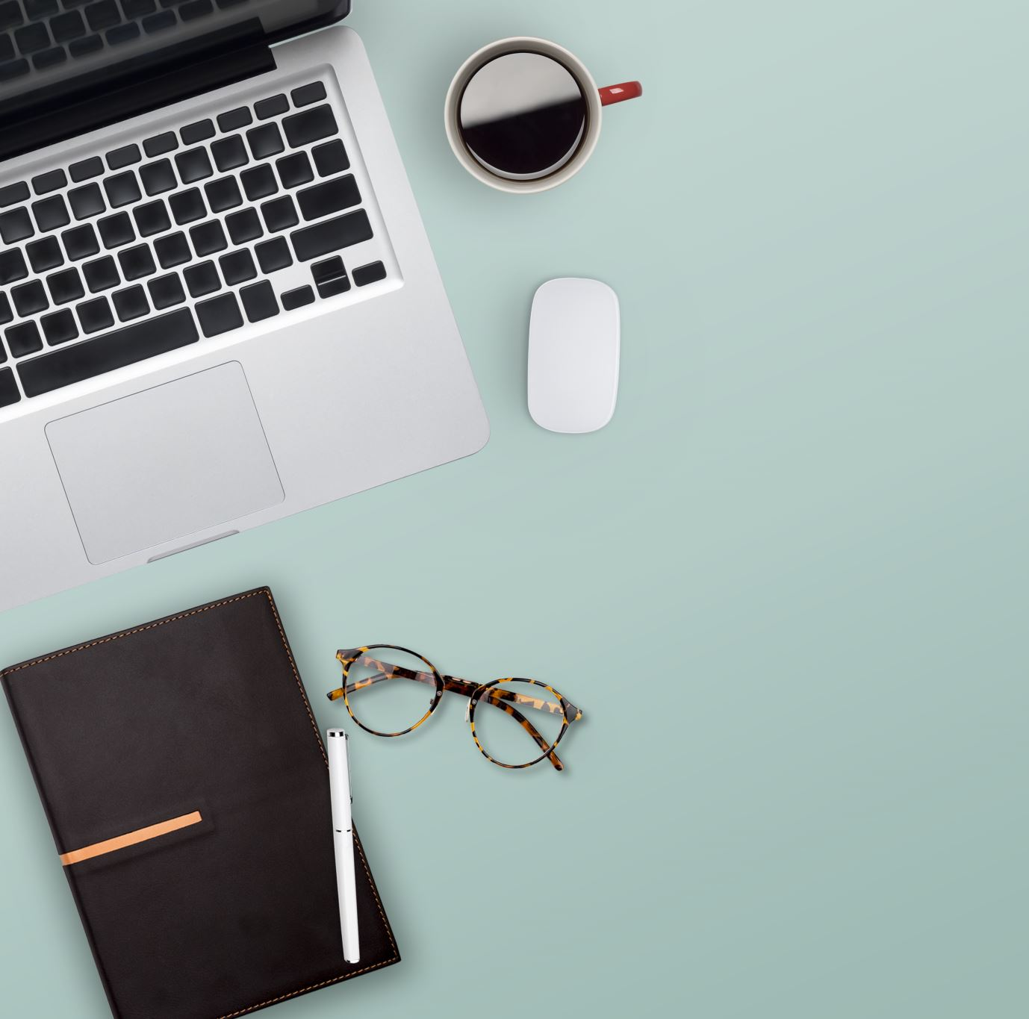
SPOTIFY DESIGN
BY SAFA GHELA

Slide 2
D&AD - SPOTIFY DESIGN
Brief breakdown – Create a feature within Spotify that helps people easily share their content and get people talking about it on their social feeds, i.e. – Twitter, Snapchat, Facebook, Instagram.
Requirements and tips:
Be diverse
Be in the moment even apart
Use lockdown and the current circumstances to my advantage
Focus on core concept behind your idea and how you can express it
Make the listening experience a social experience by enabling people to share the audio that means most to them

Slide 3
Target audience:
Influencers of all types
People who love audio, podcasts, music and more and want to socialise around their passions and share them with others.
Social Trendsetters
Master curators
An influencer doesn’t need to have 100,000 followers, it can be anyone of influence within a social group.
About Spotify (information provided) :
Spotify transformed the way people enjoy audio by letting users stream on demand. Today millions of people in 92 countries and territories have access to over 60 million tracks, whenever and wherever they want. Spotify is not just about listening to what you love, it’s also about the element of discovery, browsing artists collections, listening to radio stations, or tuning into your friends for jams. Spotify’s personality is casual, relatable, friendly, empathetic and self aware.
More about Spotify (Independent research) :
Spotify transformed music listening forever when it launched in 2008. Today Spotify is the worlds most popular audio streaming subscription service with 320m users, including 144m subscribers across 92 markets.

Slide 4
144 million subscribers
320 million active users every month
Spotify is available in 92 Markets
60 million + tracks
1.9 million + podcasts
4 billion + playlists
June 2018, Spotify had 1742 genres, December 10th Spotify had 2424 different genres.

Slide 5
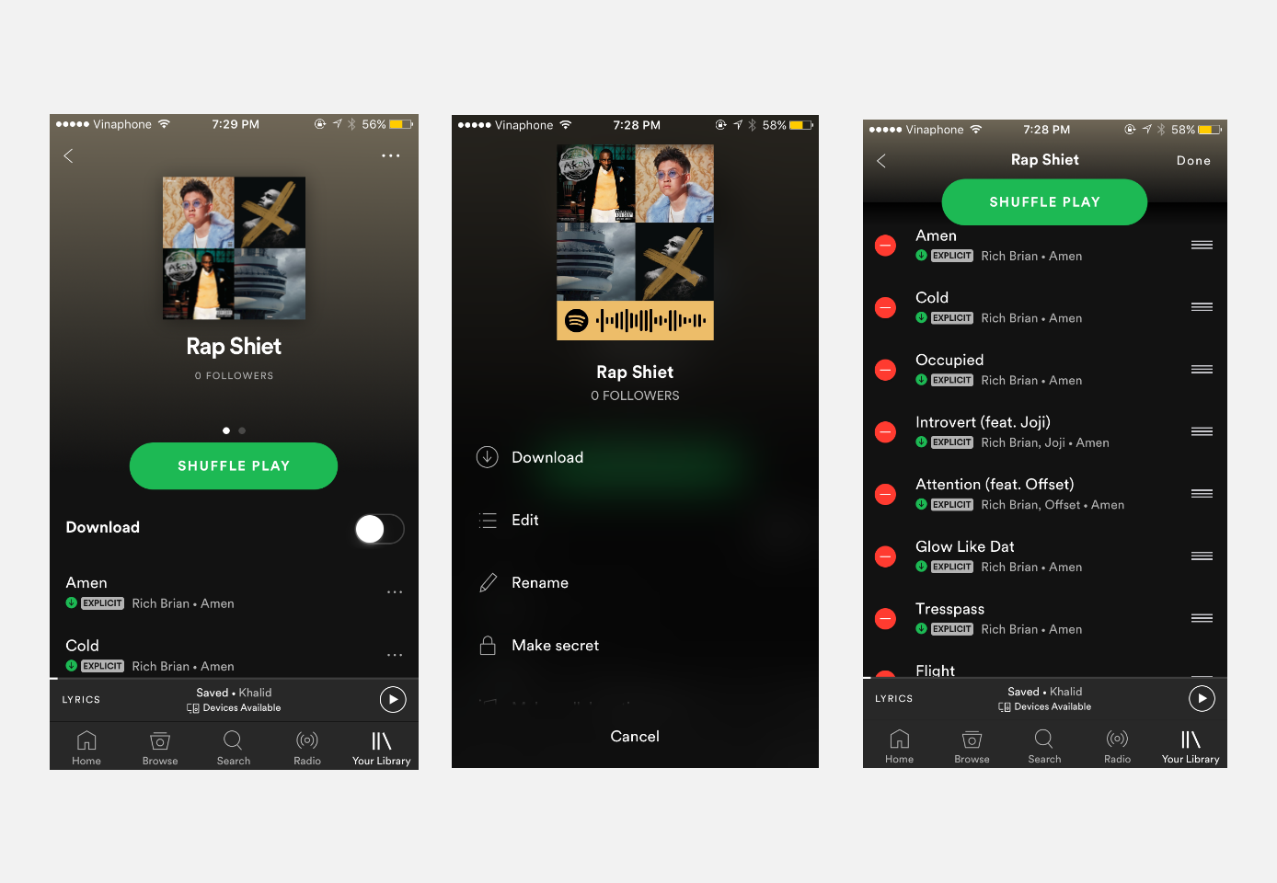
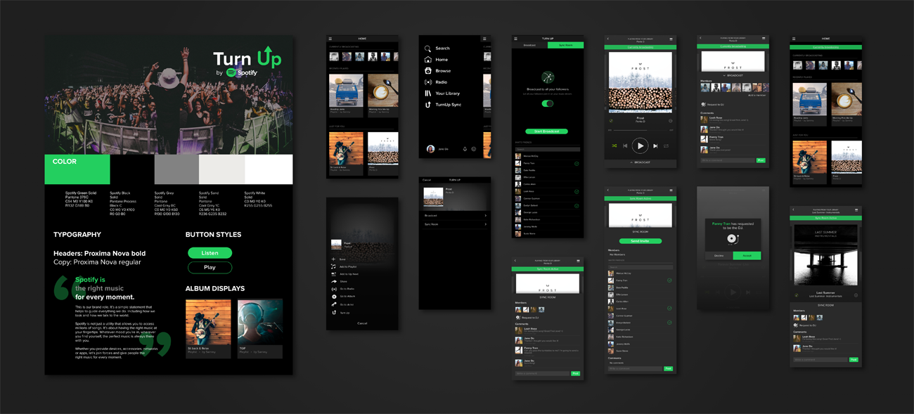
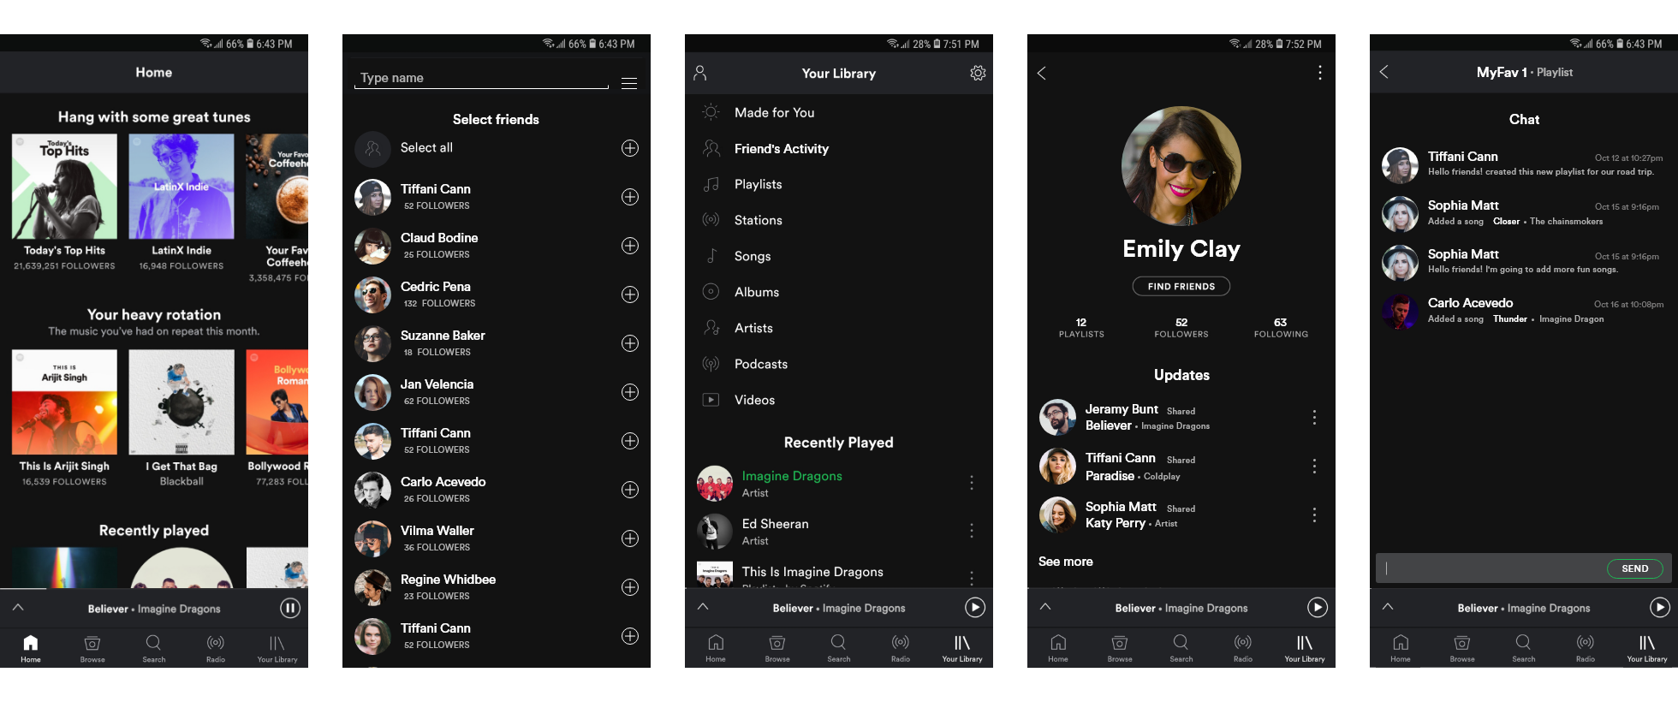
Visual Research
So far I have looked at a few ui/ux design examples online to help inspire me on what I want my work to look like. I have never designed a ui/ux design before, so this research was very important for me.

Slide 6
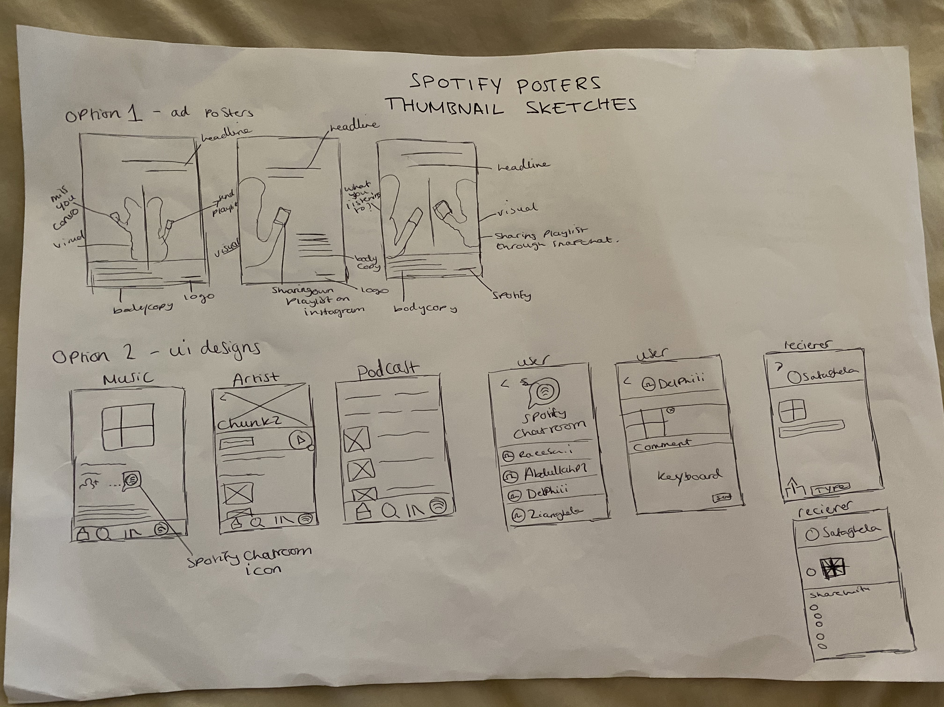
Thumbnail sketches
UI designs, I have drawn out roughly what I want my outcome to be like, the feature I want to create within Spotify is a chatroom, where people can use the app directly to send their playlists, artists and podcasts over to their friends and they can choose to /share it on their social media platforms.

Slide 7

Ideas
I want to incorporate todays circumstances somewhere within my design to also represent the idea of sharing what you’re listening to with your loved ones to keep in touch with one another
I will do this by creating chats that will show what circumstances we are in right now, playlists inspired by it – to motivate us to keep going

Slide 8
Digital creativity
I used the Spotify app to screenshot playlists, artists, podcasts, keyboard and their sharing element to use in my design to make it look as real as possible so it would help visualise how it would look in the actual app.
I downloaded a iphone 11 pro psd file from mockupworld, to paste my design on
However, once I pasted the screenshots into Adobe Illustrator to create clipping masks they became pixelated, so I had to take them into Adobe photoshop to turn them into psd files. It turned out successful and I was now able to begin designing.

Slide 9
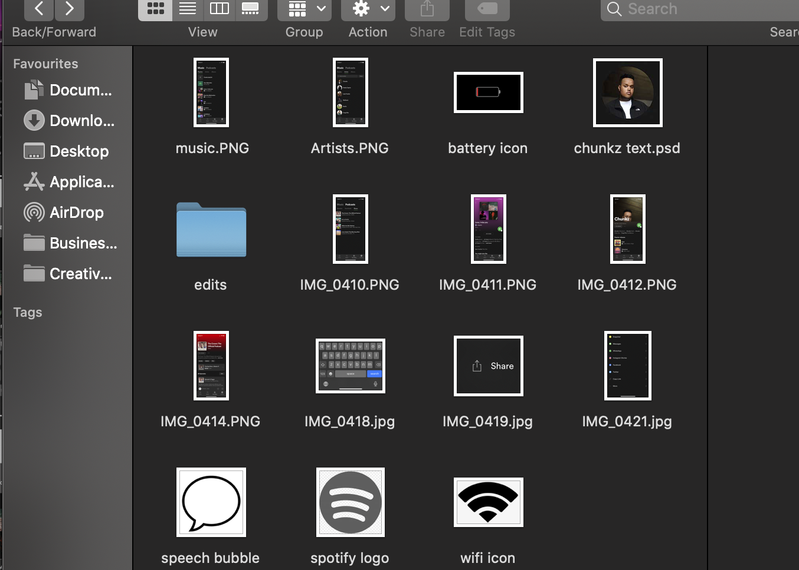
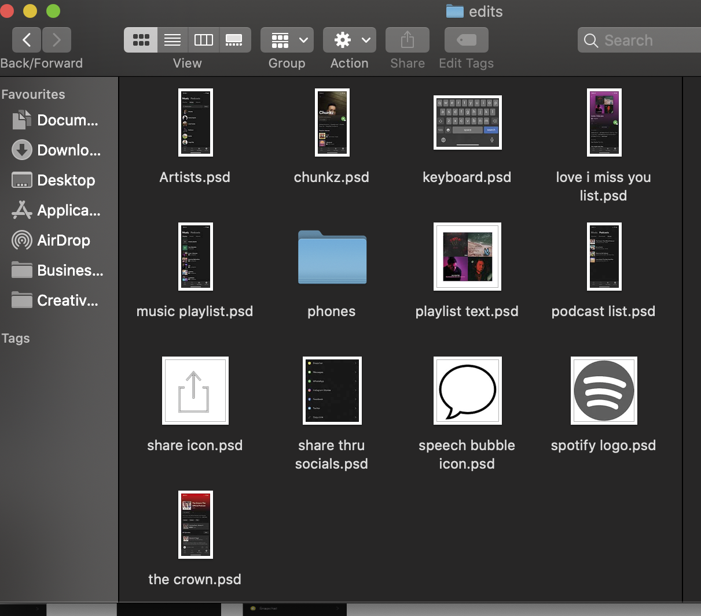
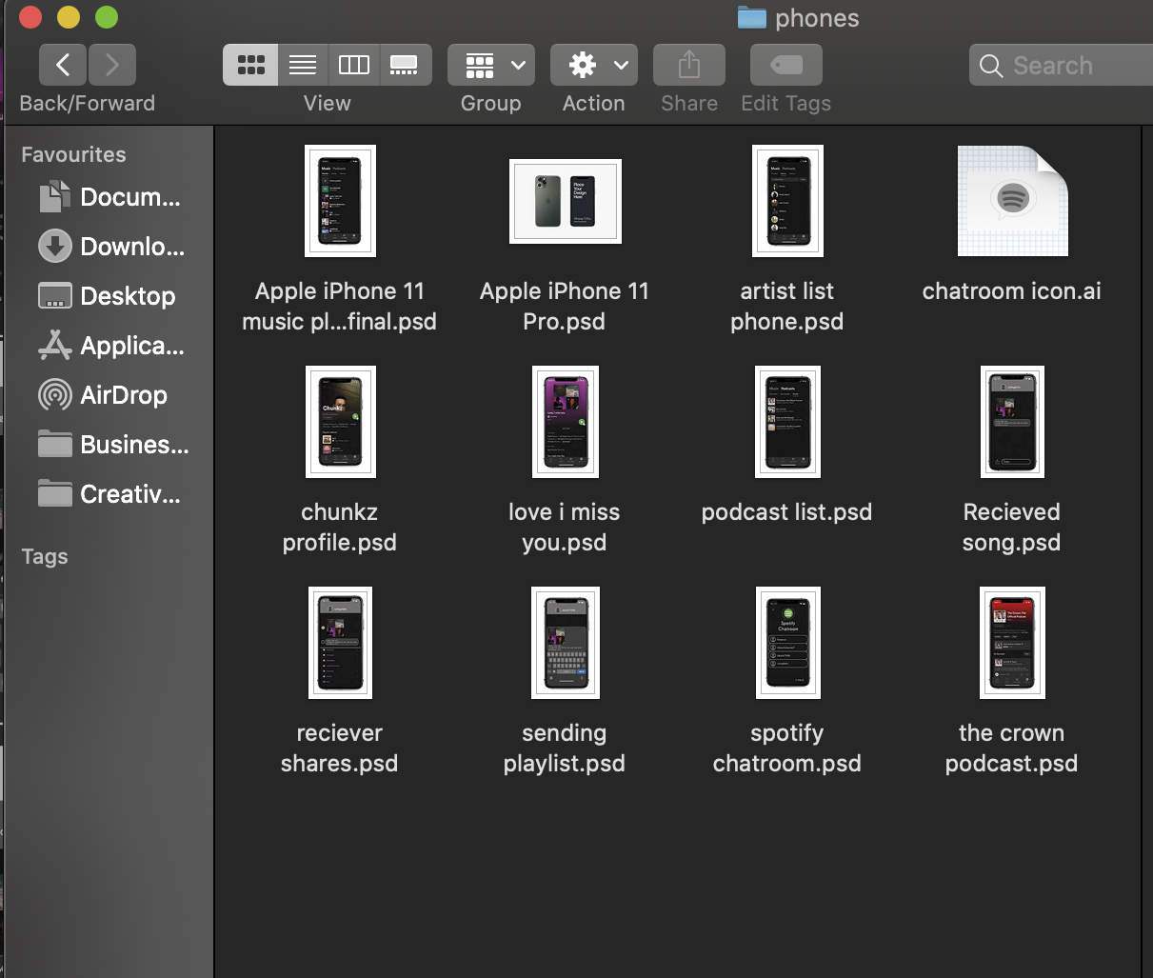

Slide 10
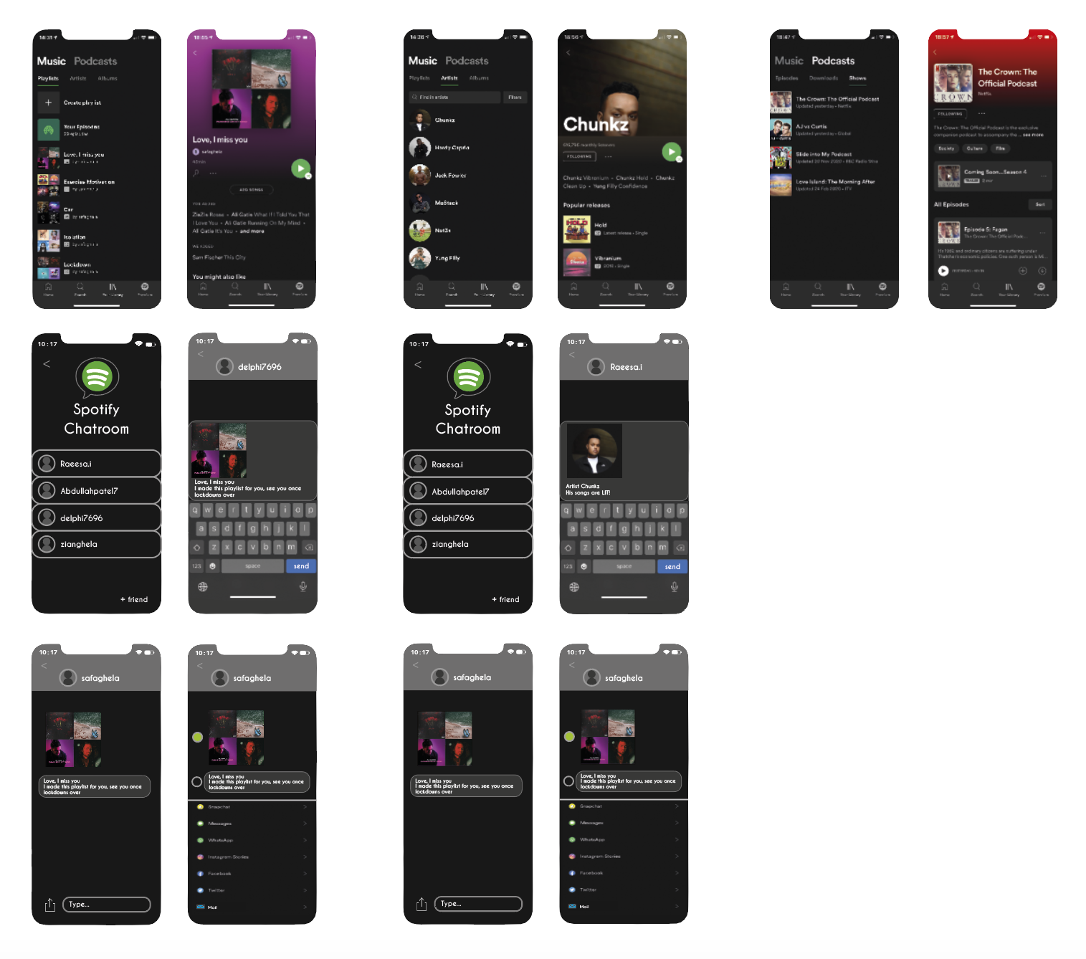
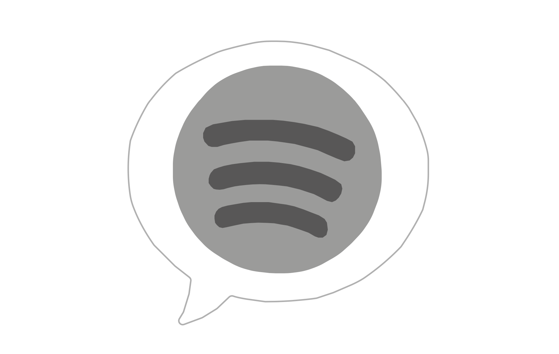
Clipping masks that I created for the shape of the phone once they are complete, I’ll be taking them into photoshop to place on the iPhone mock up
I also created that icon as the chatroom icon

Slide 11
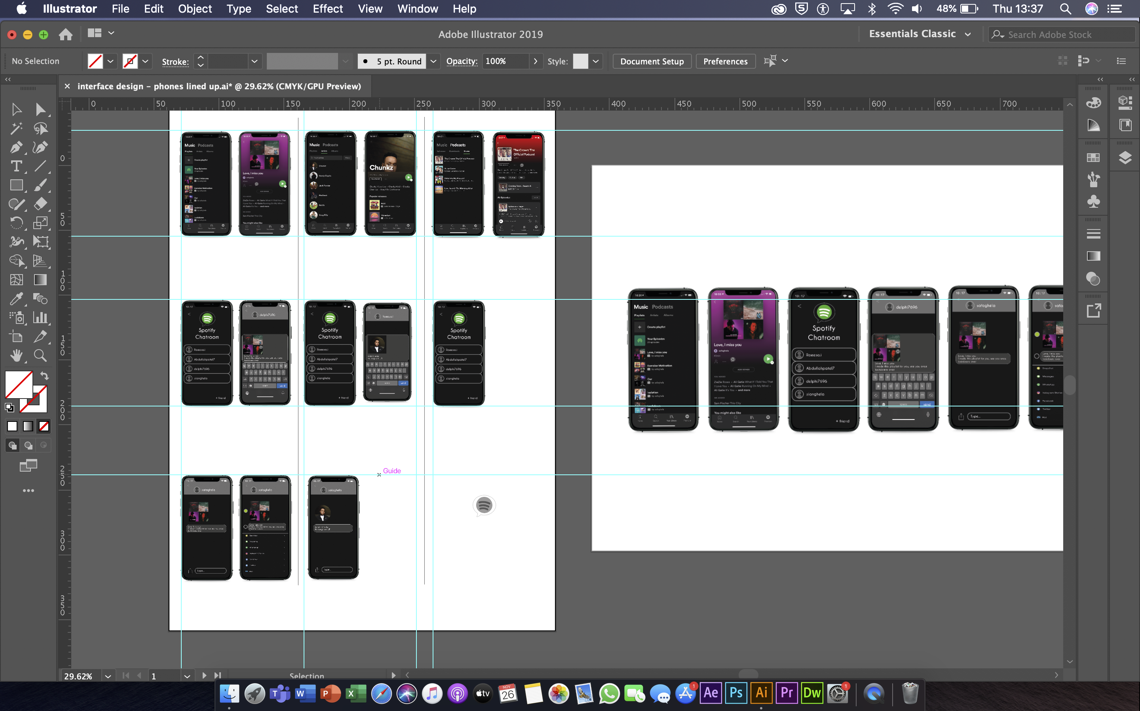

Slide 12
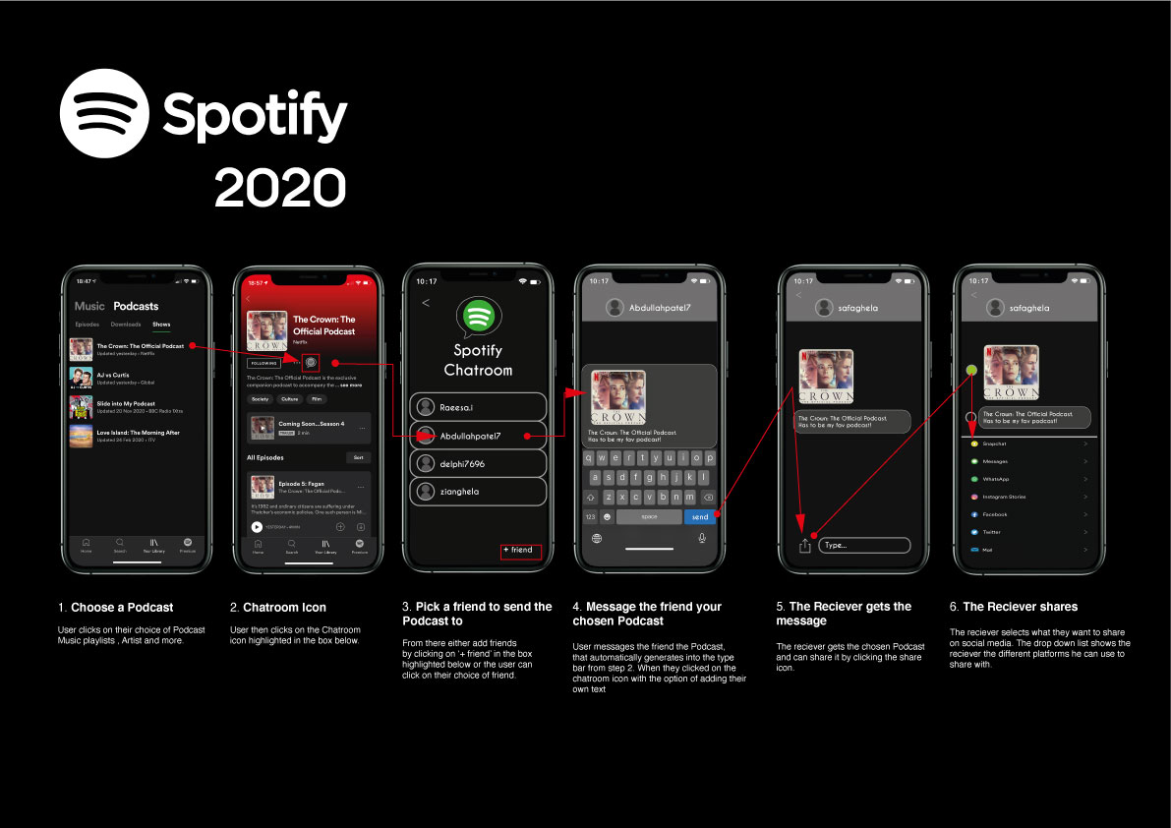
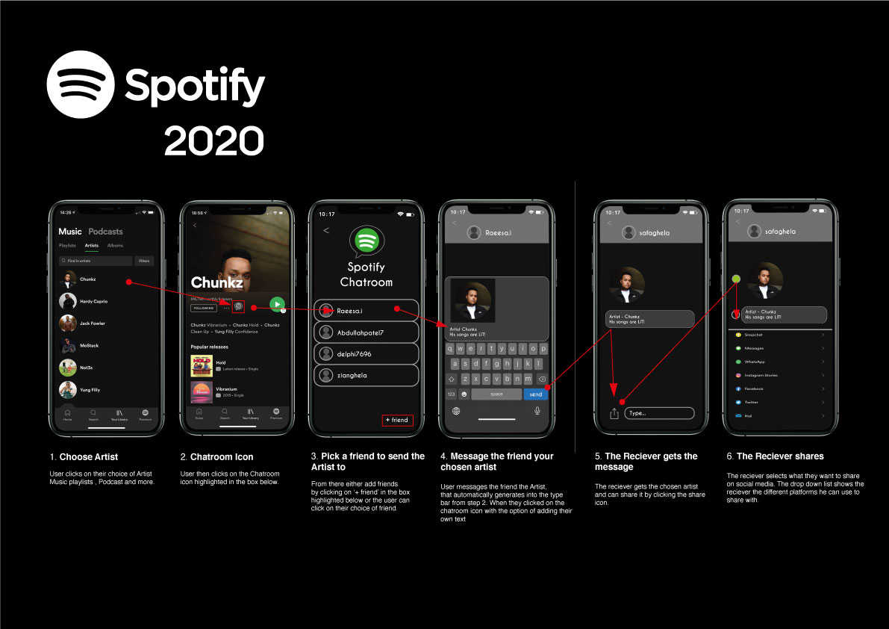
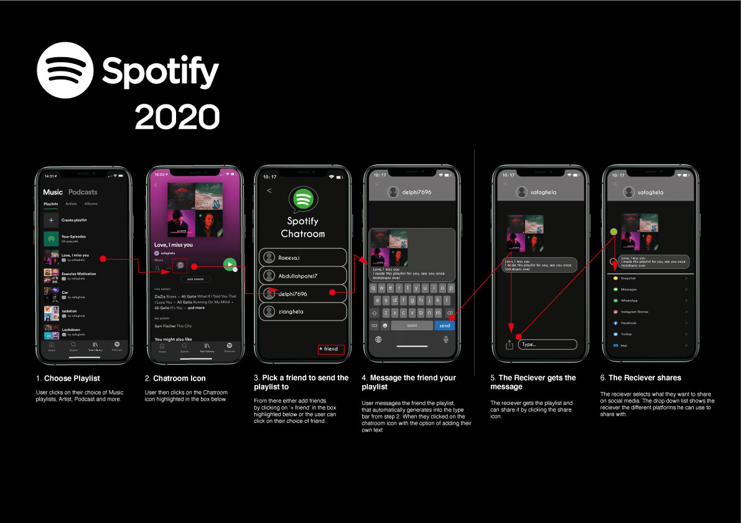
My solution

